Slide 1
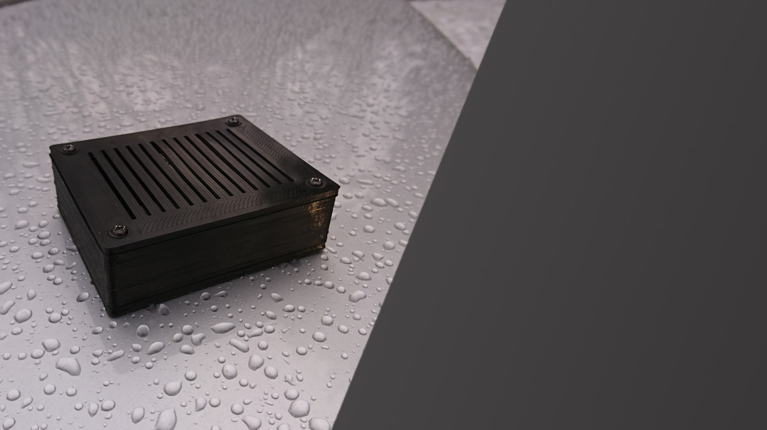
VMD
A Finnish & Belgian Student Project

Slide 2
Data flow
Flow of data from device to user interface
Sensors
Device
DataBase
API
App
Type sensors
DHT22 for Temperature and Humidity
(Printed Electronics)
Convert
Convert measured values
Use values in query
Push to DB
Bridge
Collects the data
Makes the relations
Bridge between Hardware/Software
Json Format
CRUD operations
User Interface
Graphs
Tables
Status
User Control

Slide 3

Database &
API communication

Slide 4




Used Technologies
Database + deployment
SQL on Google Cloud
Full REST API
NodeJS + Express
Cross Domain Communication
Cors

Slide 5
Why Google Cloud?
1
Wide range of vareity
Google has a lot of services available
2
Easy to manage
VM's and SQL server are easy to manage
3
Easy setup
VM's and SQL server up and running in few clicks
4
Unlimited credits

Slide 6
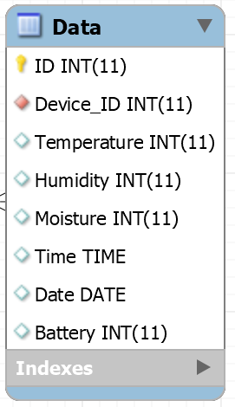
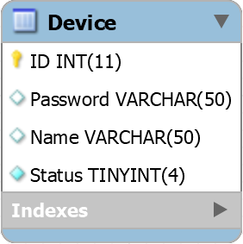
Database
Structure

Slide 7
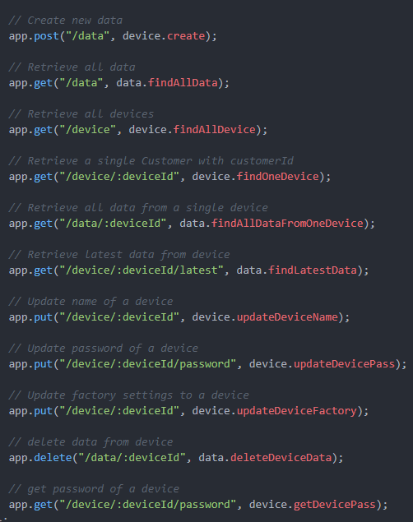
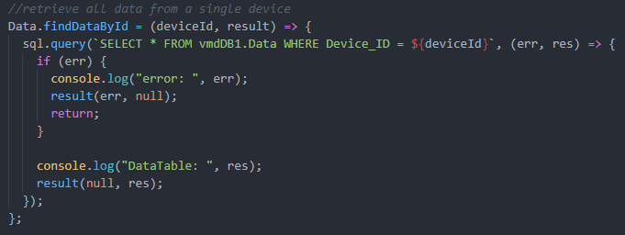
REST API:
Some
Code
Examples
CRUD Operations

Slide 8
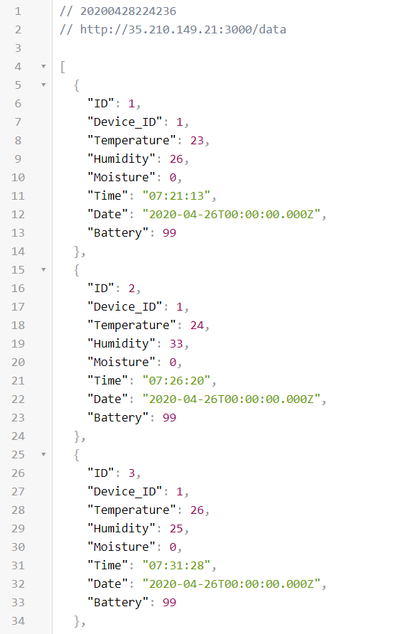
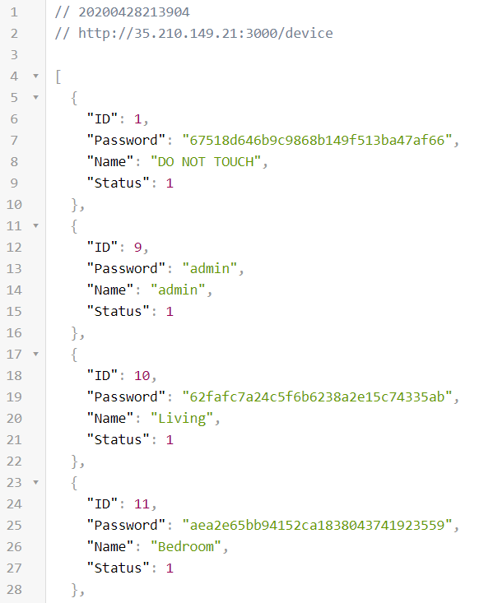
REST API: Result

Slide 9
Application

Slide 10
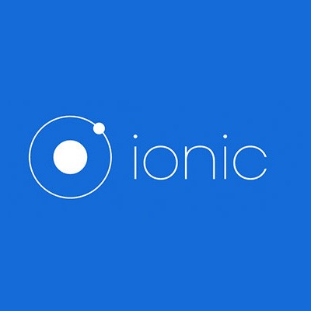



Used Technologies
Ionic
Cross platform app builder
Android
Building of App
Angular
Coding framework
Cordova
Native plugins

Slide 11
General

Slide 12
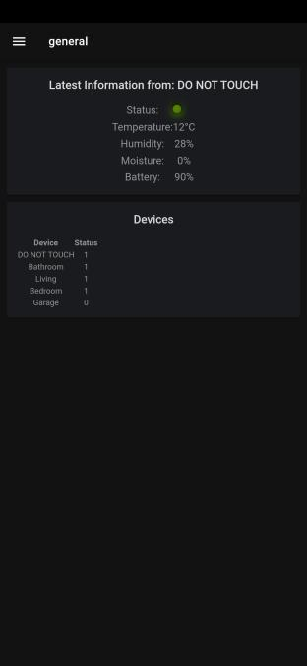
What can we see on this page?
Latest Information
On this page we can see the latest known data from a device.
You can see the status of the device from this moment (online or offline).
Latest temperature,humidity and moisture updates.
Also the current battery percentage.
Status from the devices
Also in the general page there is an overview of the status from all connected devices.

Slide 13
Temperature,
Humidity,
Moisture
&
Dew point

Slide 14
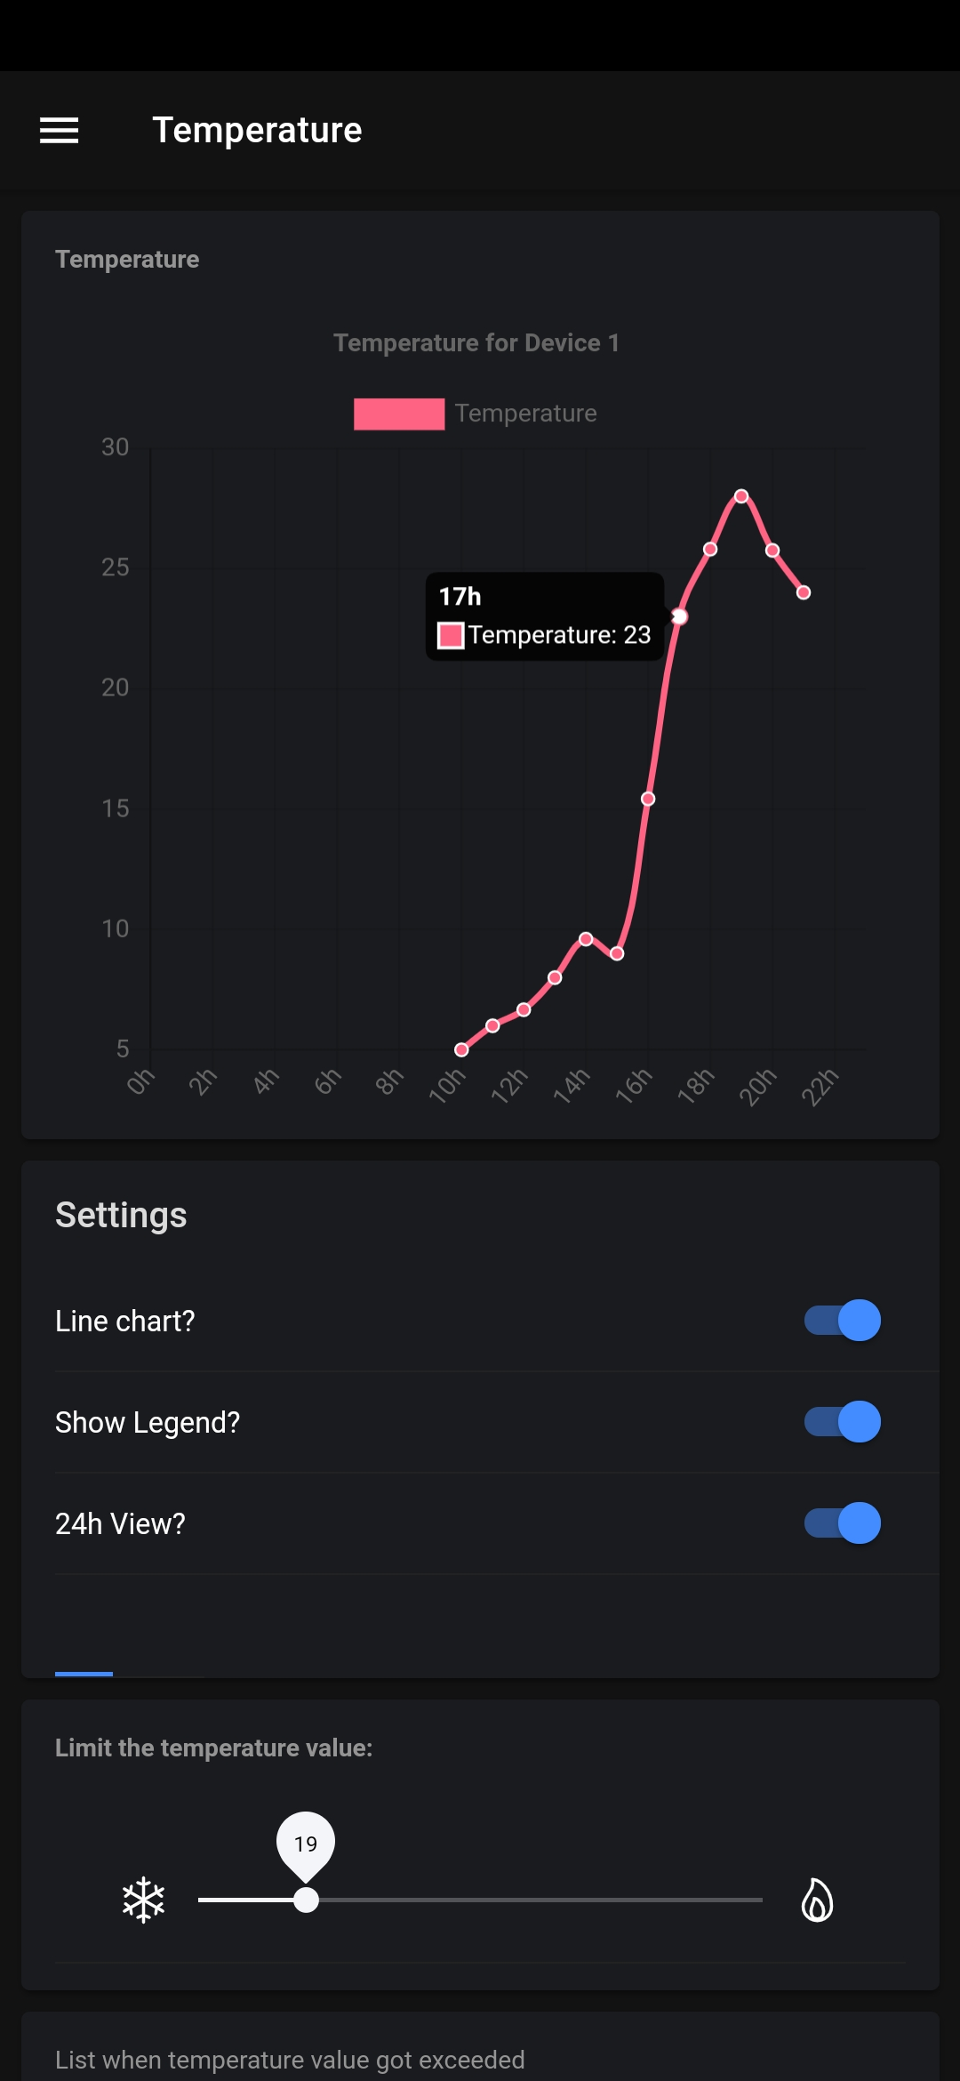
what did we use to create these pages?
Ionic native StorageService
01
To access the device storage and to enable read, write actions.
ToastController
02
To enable in-page notifications when a write action got triggered.
03
Chart.js
To display those good-looking charts.
Platform
04
To access the device hardware (e.g. to check if the device is ready to read memory).

Slide 15
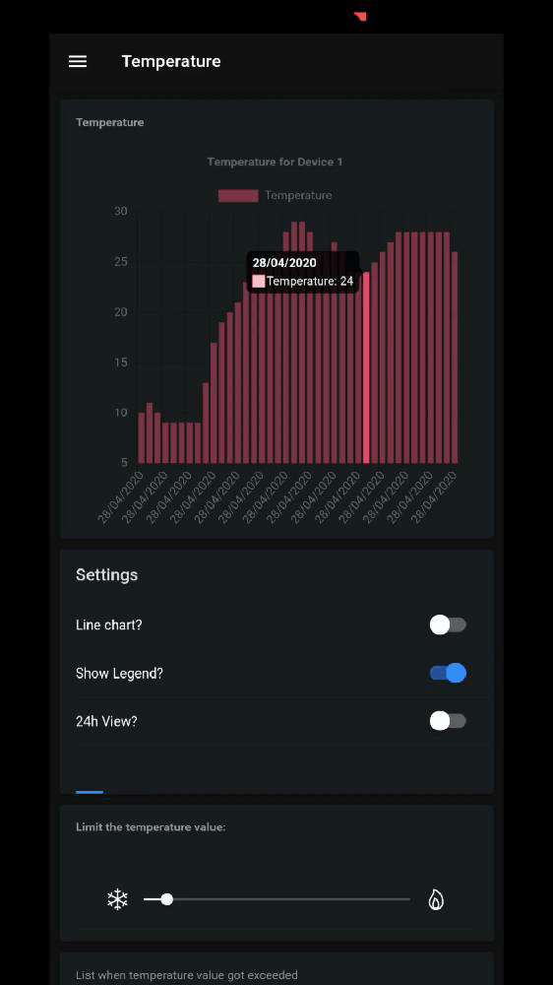
Humidity, temperature & Moisture
How does it work?
We check the database for new data every minute.
When new data is available, the charts update automatically.
We can set a limit. If the temperature, humidity or moisture level drops below the set limit the app sends the user a notification. The date & value is saved on the memory of the device.
These buttons are used to edit the graph.

Slide 16
Settings

Slide 17
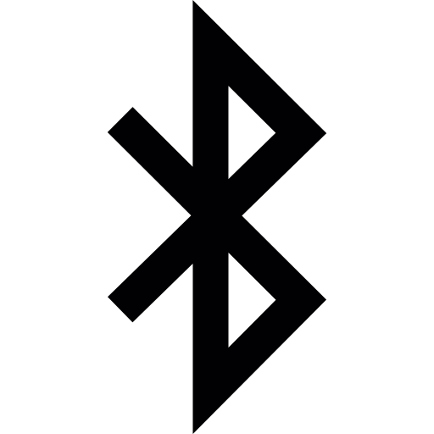
Settings
01
Bluetooth
Bluetooth connection between app and device.
02
Change device name
Select device and give it a new name.
03
Change password
Select device and give it a new password.
04
Enable/Disable features
Automatic requests to the database.

Slide 18
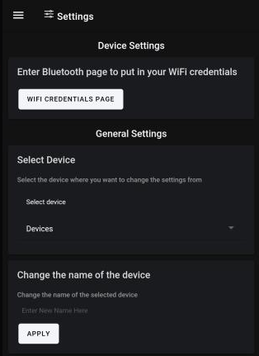
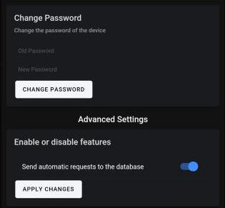
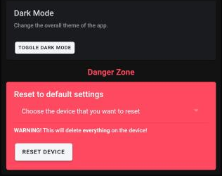
Settings
05
Dark Mode
Change the theme of the app to dark mode.
06
Factory Settings
Select device and delete/set it’s data to default.

Slide 19
Bluetooth

Slide 20
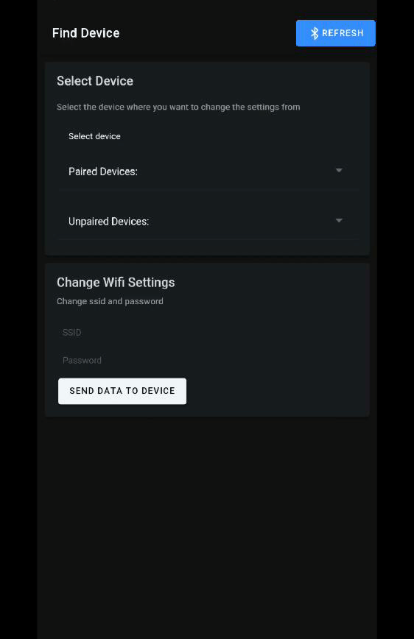
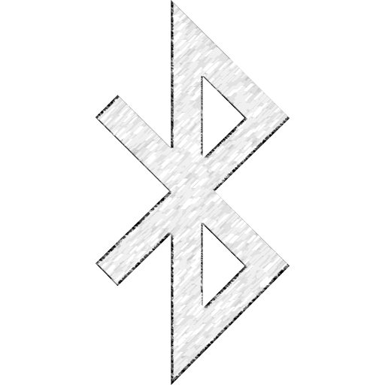
So, how does it work?
With help from the Cordova Bluetooth serial plugin!
The connection happens in a few steps
Scan for devices
Select the device
Enter your SSID & Password
Send the data to database
Cordova plugin
Bluetooth serial plugin, to communicate with the device

Slide 21
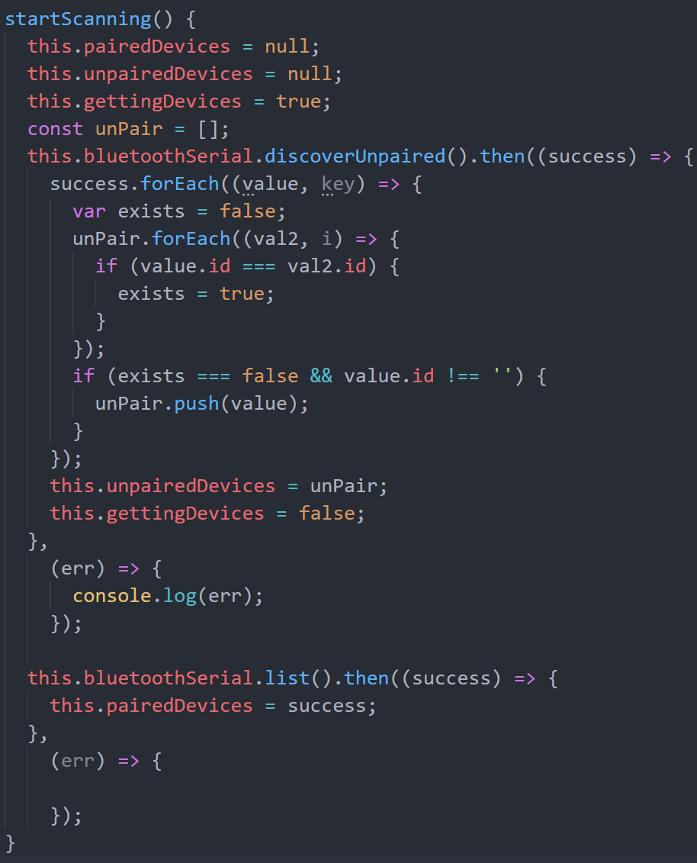
Some
Code
Examples
Some
Code
Examples
This piece of code lets the device search for unknown Bluetooth devices in the area.
When the device detects an unknown device, it gets added to the “unpairedDevices” list.
We are listing all paired devices.
And then add them to the list

Slide 22
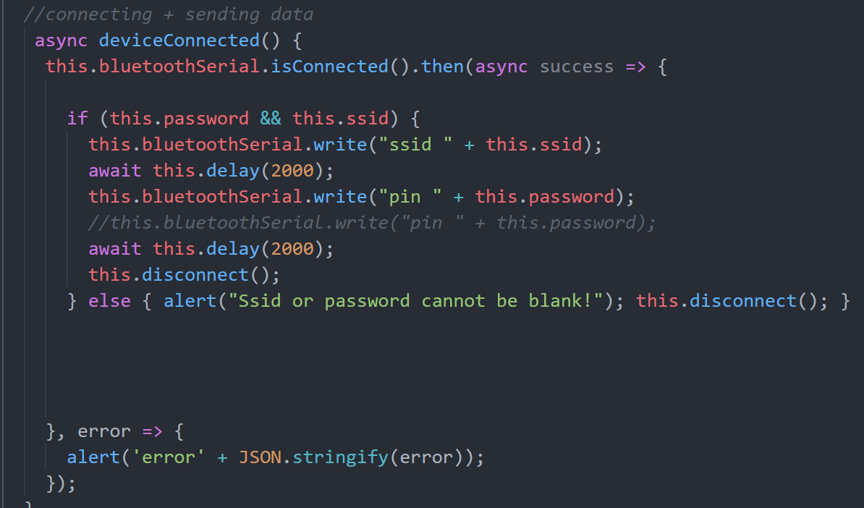
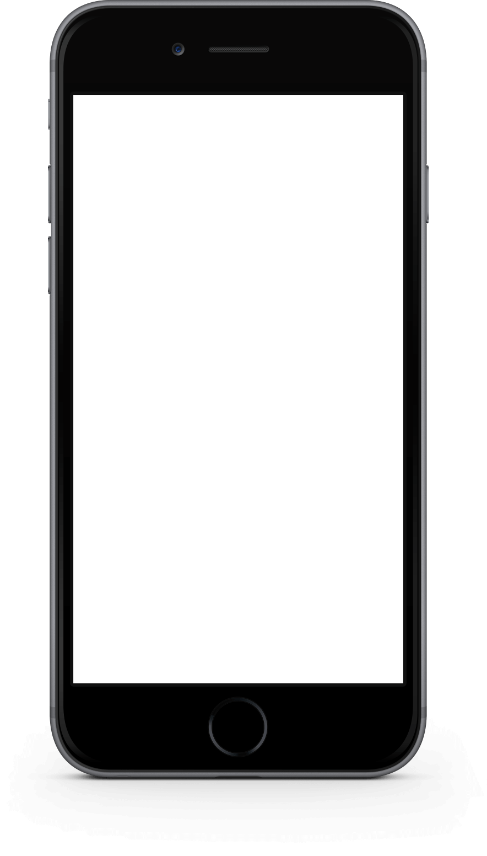
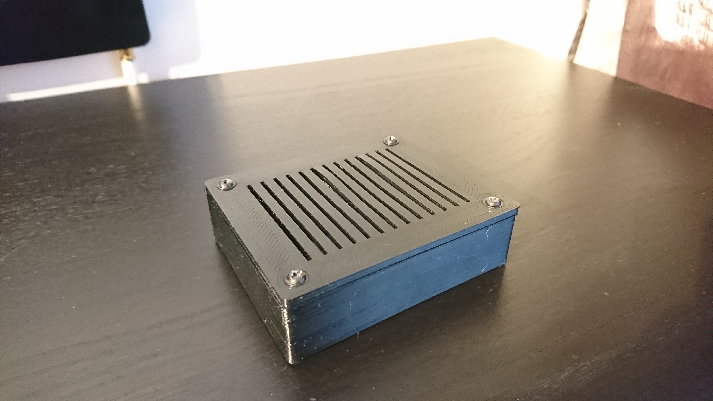

Some
Code
Examples
This piece of code checks if the device is connected.
If the device is connected, then we can send the SSID & password to the device
Done!

Slide 23
Notifications

Slide 24
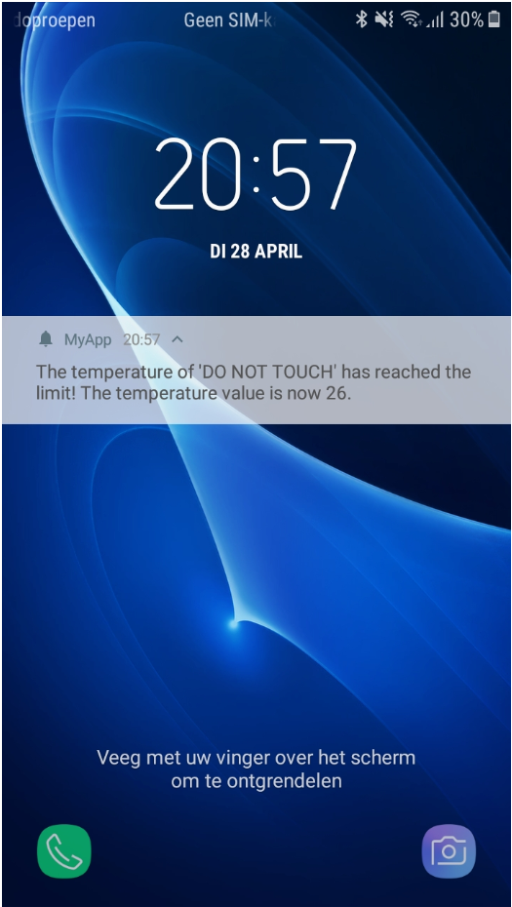

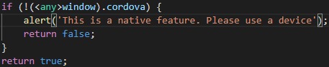

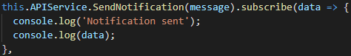
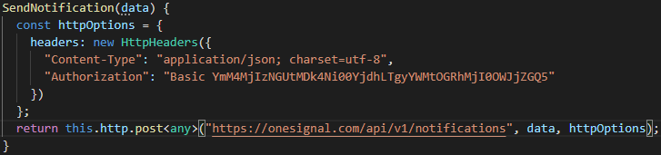
Notifications
Start Up
Subscribe
Check if device is real
Subscribe to service
Push Notifications
Send
Receive
Send it to the OneSignal API
The user will receive the notification

Slide 25
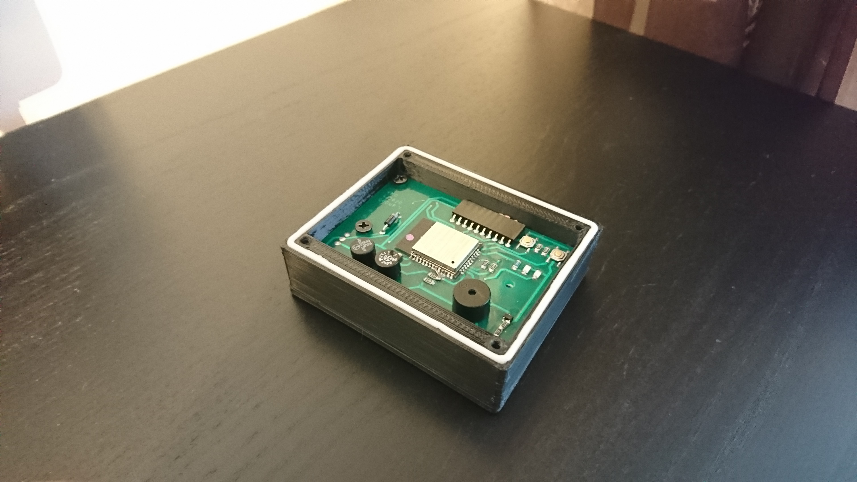
Live Demo

Slide 26
Conclusion
Our Goals
Most of our set goals were achieved
Only moisture setting could not be finalised and some QoL features
Our Thoughts
Was a great learning experience
Communication went well

Slide 27
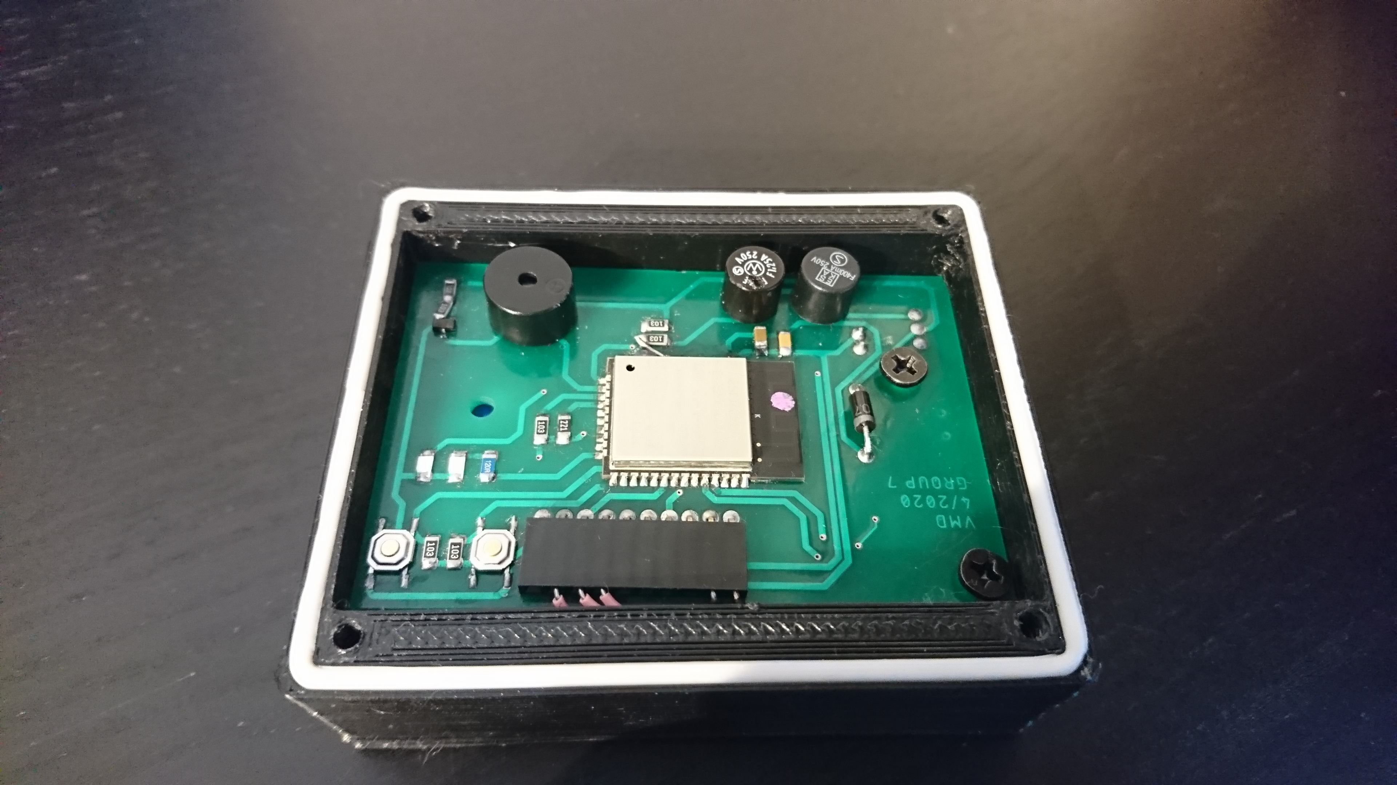
Thank you
For Listening
Finland:
Ville Tähtinen
Kalle Hookana
Oskari Siipola
Belgium
Usman Shani
Maxime Minta
Jens Van Goethem
Arne Janssens
Amaury Verschooren

